Slide 1
Music Recommendation from the Million Song Dataset Bernard Bollinger (305822288)

Slide 2
Project Goal
Prompt the user for a song
Give the user a list of songs similar to the song that they provided

Slide 3
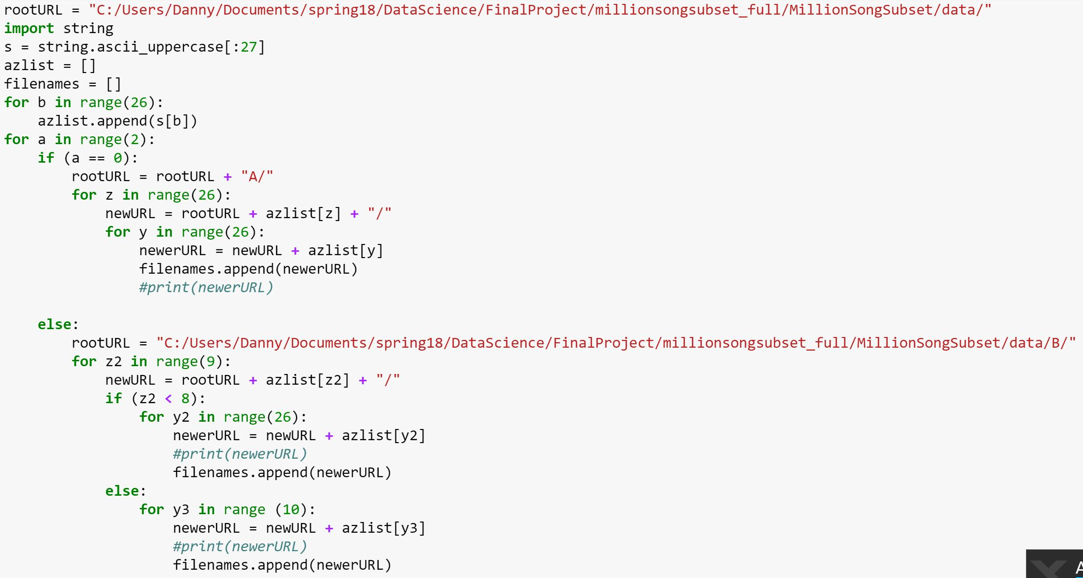
Datasets and APIs – The Million Song Database (MSD)
MSD has a million songs stored in hdf5 format with song analysis features for each song.
The code on the left creates the filenames to access all hdf5 files in the complicated file system

Slide 4
Datasets and APIs – Spotify API
The Spotify API has the ability to return song analyses on any song it has in its system
Spotify bought The EchoNest, who is the company who did the audio analyses for the MSD, so the audio analyses in the Spotify API are of the same type and feature name
After the user finds a song in Spotify’s system, the program will respond with songs with similar features in the MSD

Slide 5
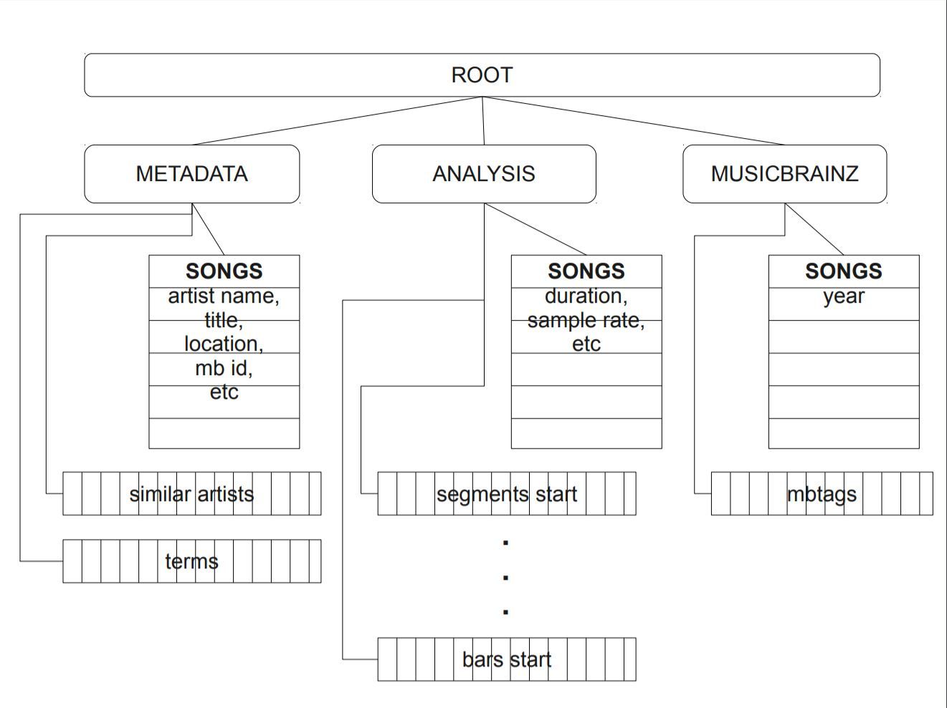
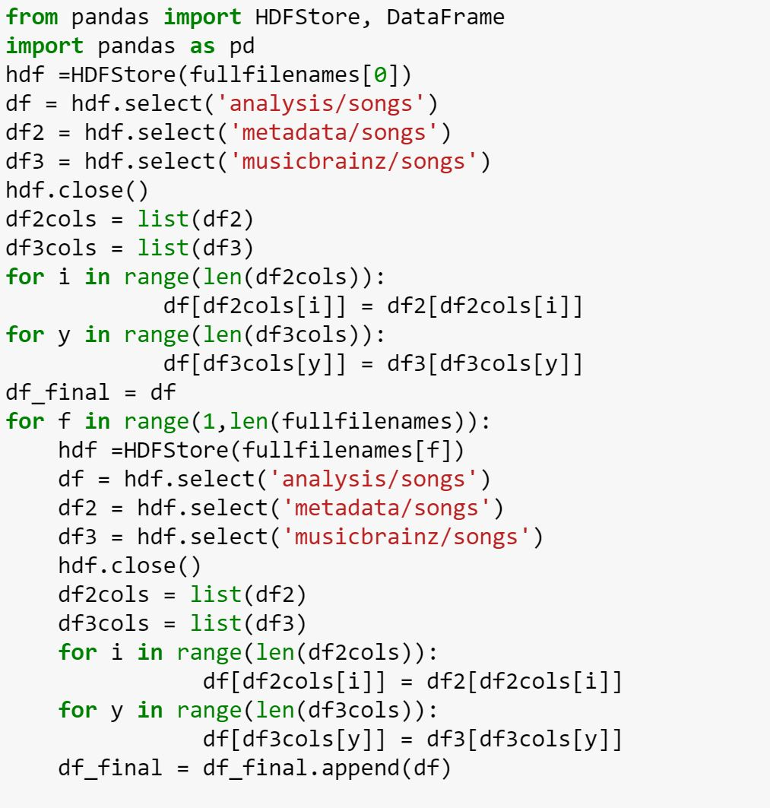
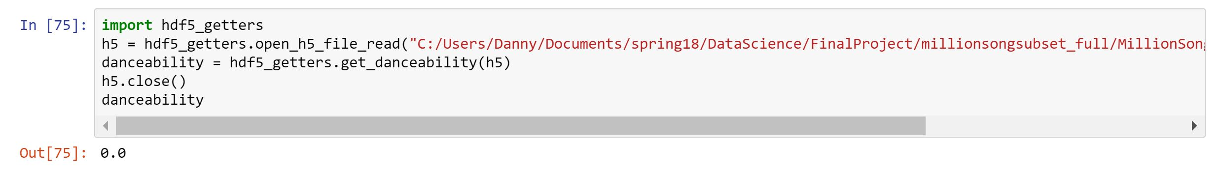
HDF5 to CSV – HDFStore & hdf5_getters
After using both the hdf5_getters python class provided with the MSD and HDFStore in pandas, neither could properly extract all information from the hdf5 file. Lists such as segments start and bars start in the schema below were unable to be extracted, and “danceability” and “energy” always returned 0 values.
Issues with some features…

Slide 6
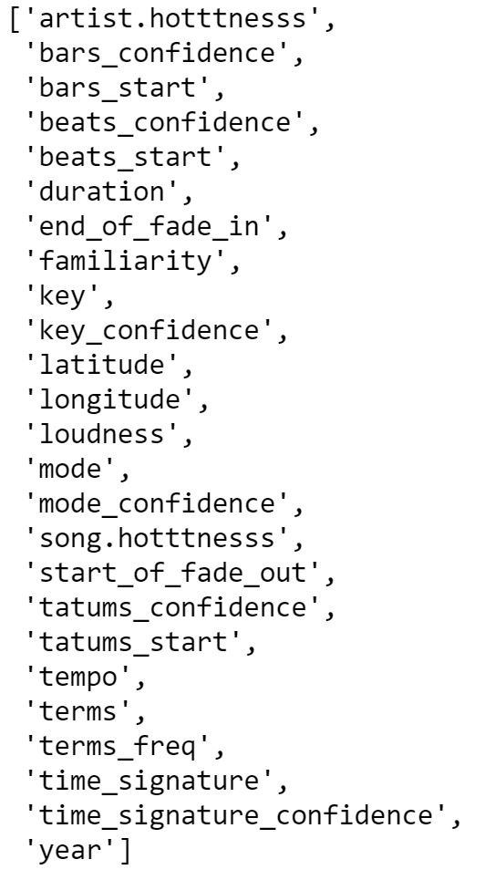
Exporting a dataset
These are the features extracted from the hdf5 data
Not all extracted features are useful for analysis
Some needed OneHotEncoding, and some needed normalization

Slide 7
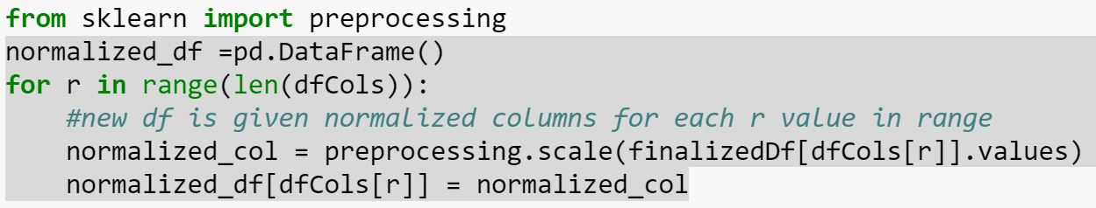
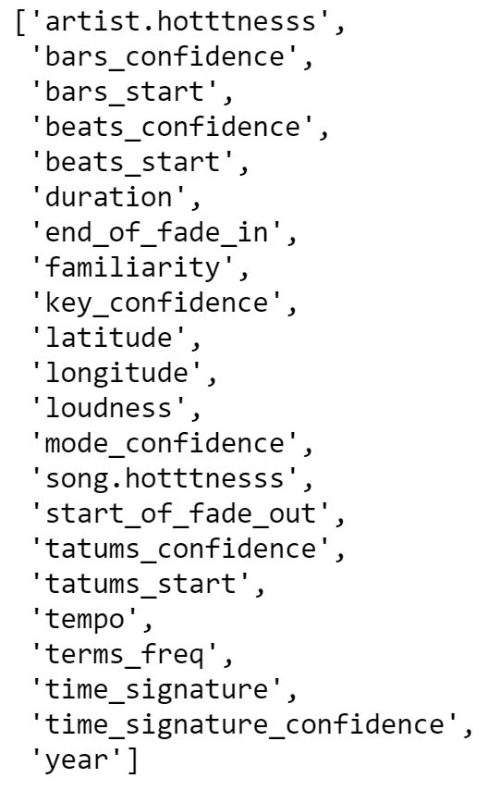
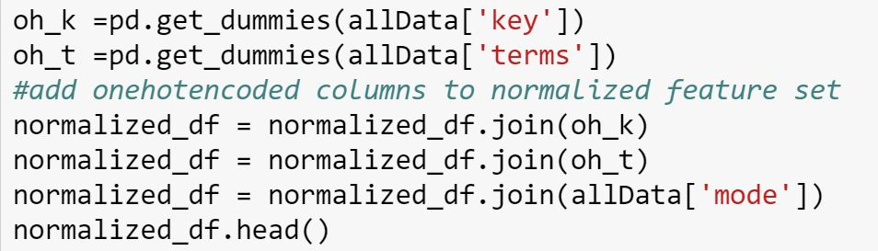
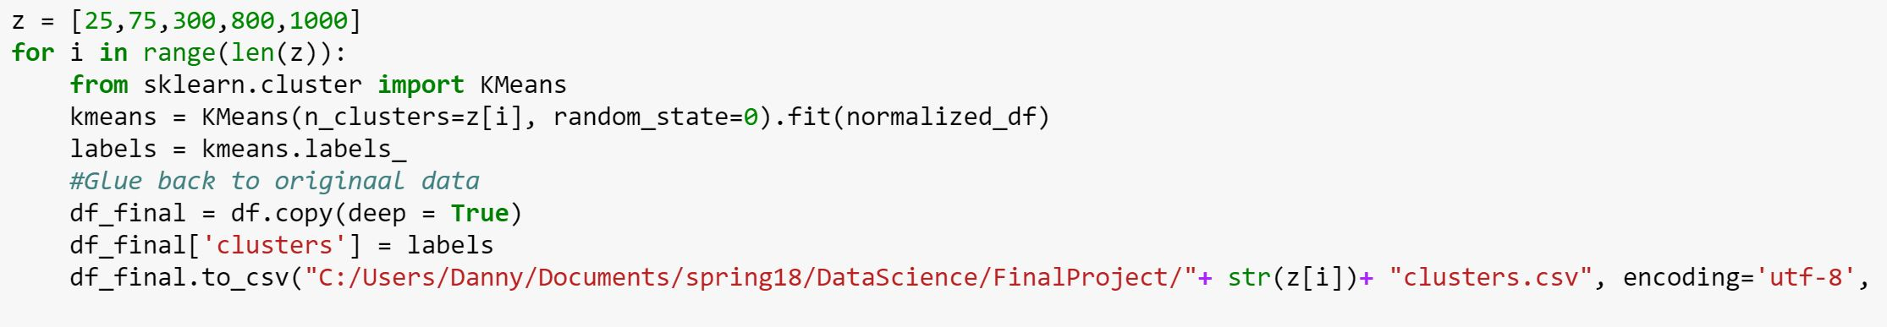
First – Clustering and Labelling
Normalizing each column after removing non-numerically ordered features
The following features were used
in the clustering stage….
Onehotencoding key (0-9) and terms (the genres)
Making clusters with different sizes, adding the cluster name back to each
row (as a label for the next step) and exporting each as a csv file

Slide 8
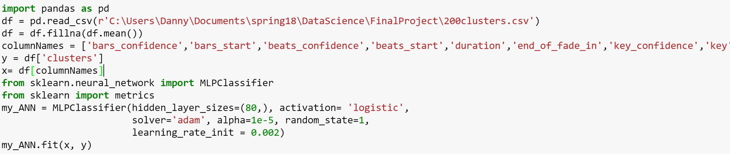
Second – Training an ANN
Using the various csv files from the last step as labelled data, a selection of features that were able to be acquired from the Spotify API is taken and used to train an ANN with the label being the cluster assigned in the last step.

Slide 9
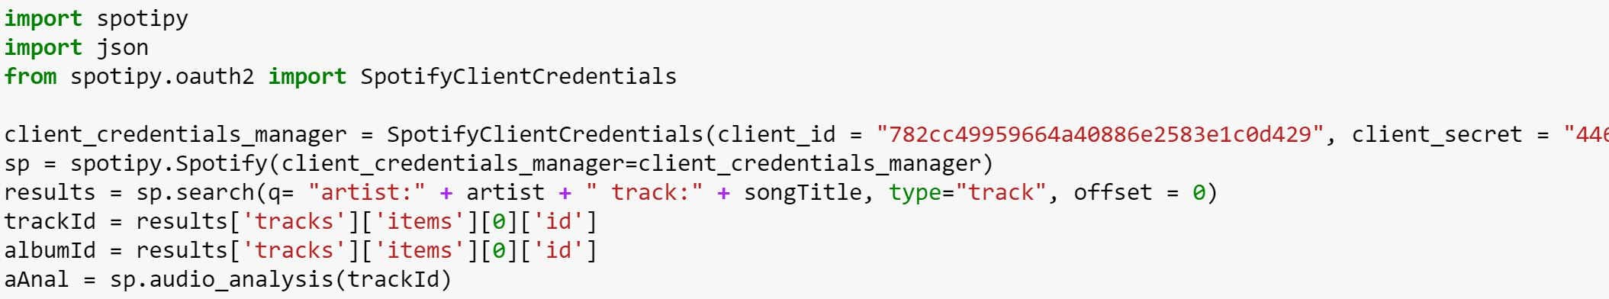
Third – Prompt user for song title and call Spotify API for song ID/ audio analysis
Using spotipy, a python library with helper classes for calling the Spotify API, I get authentication and then subsequently search for the information inputted by the user in the prompt above. The API then gives back a trackID, which can then be used to call for an audio analysis on the song from the API.

Slide 10
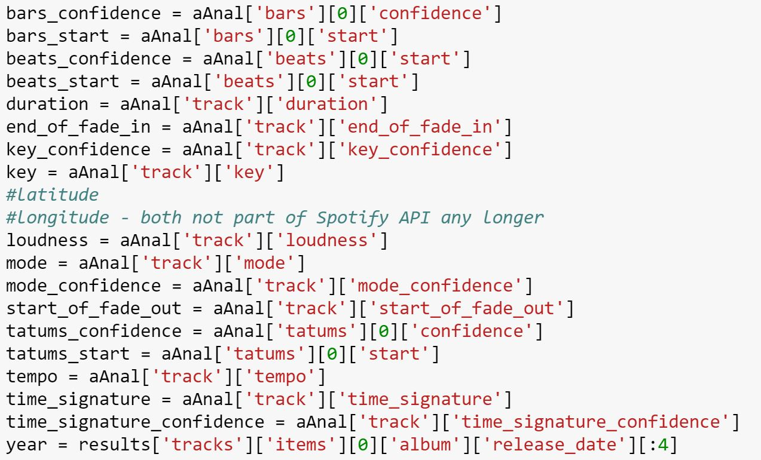
Fourth – Extract features from JSON and feed into ANN
To the left, all of the features for the song that the user inputted are being extracted from the JSON response of the audio analysis call.
Below that single row of features is fed into the ANN, and a prediction is made as to which cluster it would fit best in

Slide 11
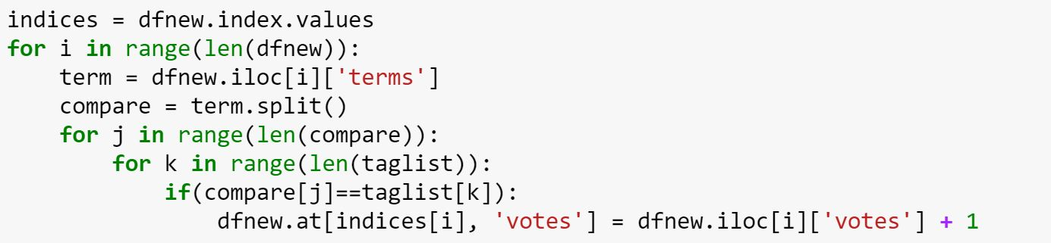
Fifth – Score results based on genre similarity
The cluster that is determined by the ANN contains all of the songs considered similar to the inputted song. Unfortunately, pure audio analysis can group together dissimilar songs with similar tempos, keys, location, etc. The bit of code above scores all songs in the chosen cluster based on similarity of genre name to that of the song that is chosen by the user.

Slide 12
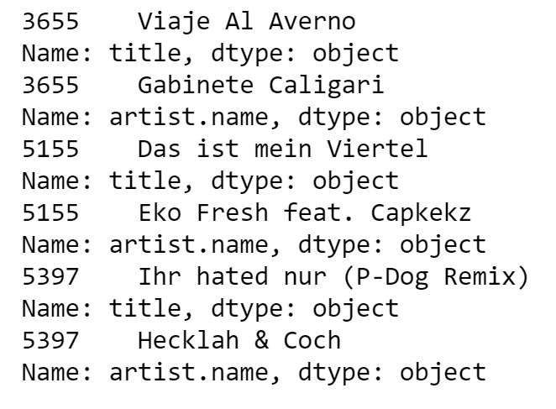
Example input and output
The songs with the highest scores, aka similarity in genre, in the cluster are then outputted for the user to check out!

